Slide 1
Classical control/readout
9 models, 3 platforms
Superconductive - conventional, SFQ, cryo-CMOS, optical, wireless
Rapped ion - microwave + B-field , laser + photonic interconnect,
on-chip RF / EQC
Neutral atom
control system → qubit environment (QPU) → readout system

Slide 2
Reusable SysML v2 model library
Four tiers, general to platform-specific — one library behind all 9 interface models
QuantumComputing — framework
1
signalSource
transducer
amplifier
signalConditioner
transmissionMedium
classicalProcessor
qubitEnvironment
+ signal & port vocabulary · QPU · qubitTechnology enum
CommonInstruments — technology-agnostic components
IQ mixer · DAC / ADC · laser source · antenna · photodiode · filter · low-noise amp · FPGA · waveguide · optical fibre
2
SuperconductingCommon
dilution refrigerator · JPA · JPM · JTL · SFQ · cryo-CMOS
AtomicCommon
vacuum chamber · magnetic-field signal + port
3
Superconducting · 5
conventional
SFQ
cryo-CMOS
optical
wireless
Trapped ion · 3
microwave + B-field
laser + photonic
on-chip RF (EQC)
Neutral atom · 1
FPGA control pipeline
4
One library across 3 qubit platforms → evidence for RQ1 (expressibility) and RQ4 (extensibility)

Slide 3
Quantum architecture opening the QPU
(in progress)
Superconducting qubit physical layer
Circuit elements modelled in detail (Josephson junction, capacitor, SQUID, junction array, resonator, mutual inductance), units matched to the reference (E/h in GHz, flux in Φ₀)
4 qubit modalities as a type taxonomy: transmon, split/tunable transmon, C-shunted flux qubit, C-shunted fluxonium
4 qubit-qubit coupling schemes: direct capacitive, capacitive via resonator bus, direct inductive, inductive via tunable coupler

Slide 4
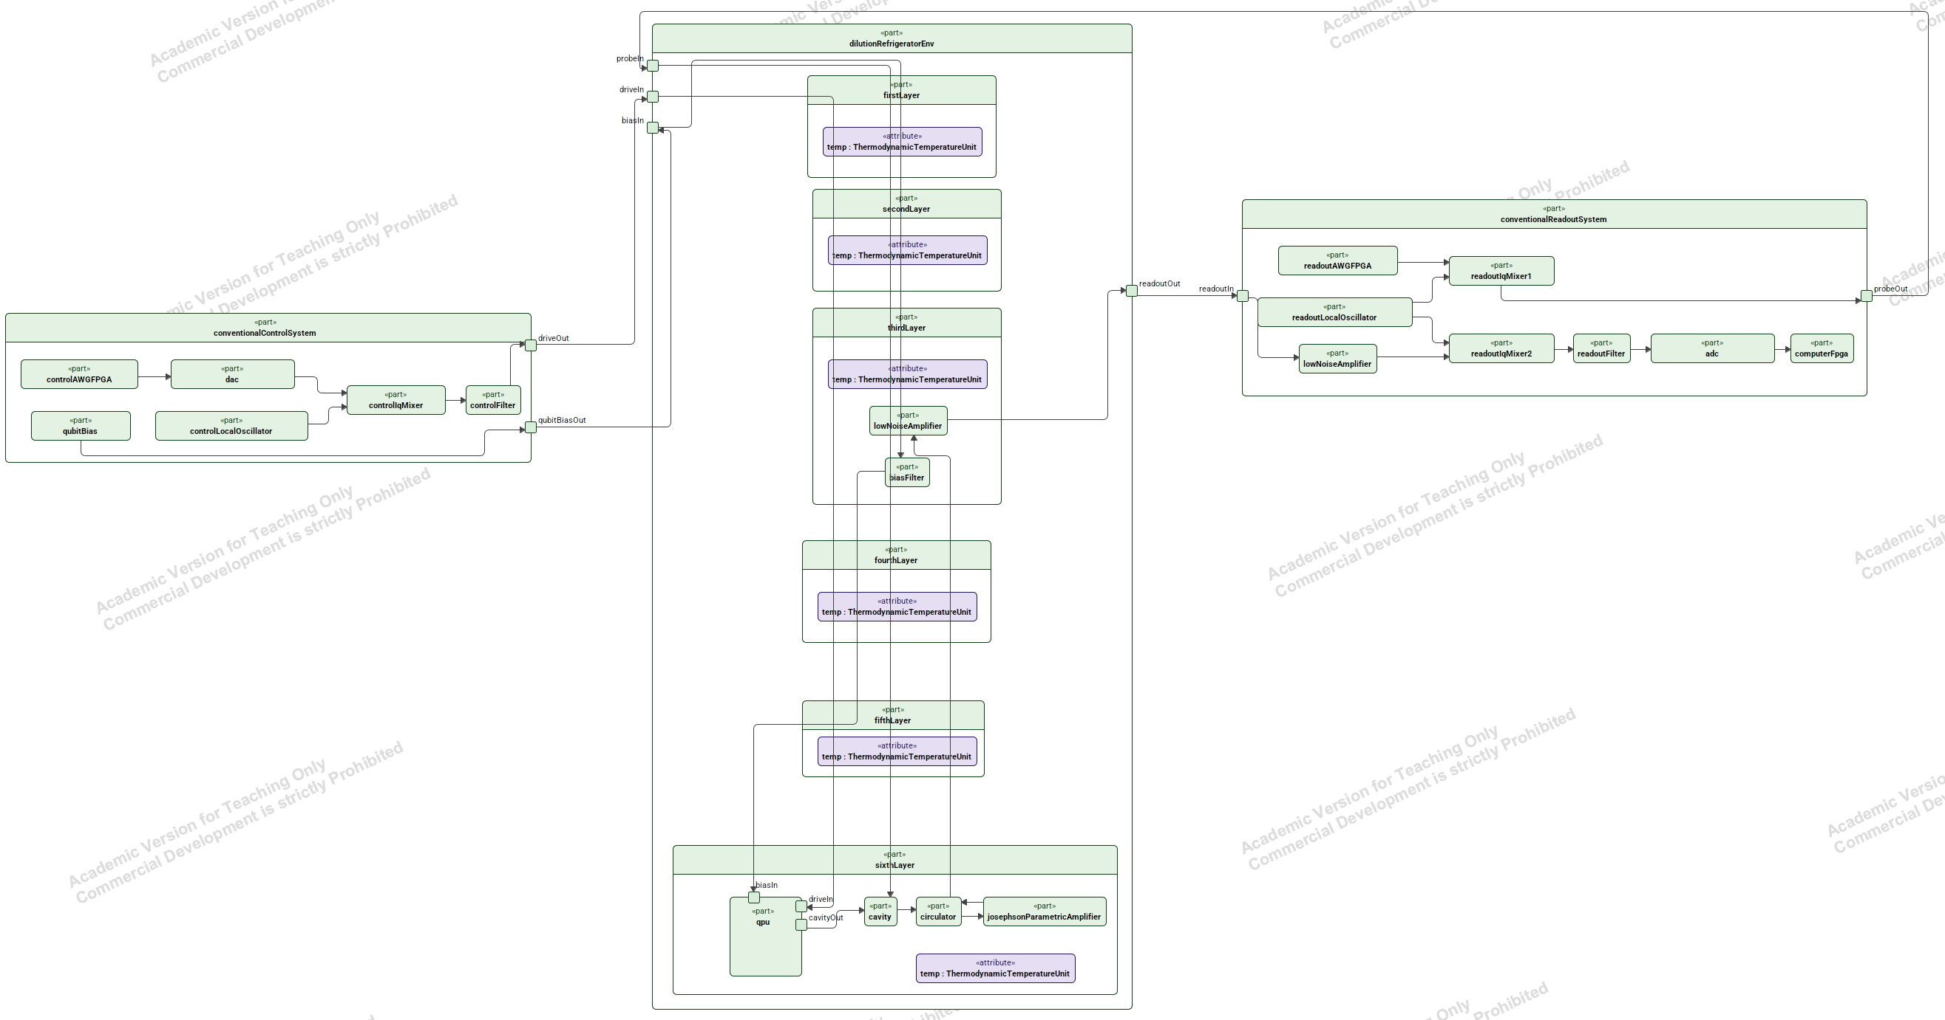

Slide 5


